Slide 1
Project 3 Regression and Classification with the Ames Housing Data
Shayne Nguyen

Slide 2
Agenda
Clean Data
Build Model
Q & A

Slide 3
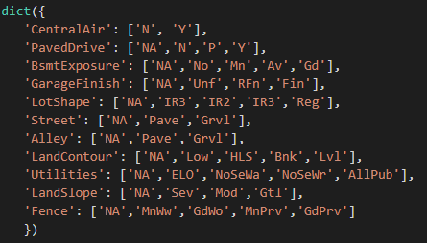
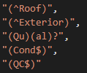
Cleaning Data
Full Data | NOT Renovate-able | ARE renovate-able | Convert-able
Pre-2010 | Df_pre_not | Df_pre_are | Df_pre_con
Post-2010 | Df_post_not | Df_post_are | Df_post_con

Slide 4
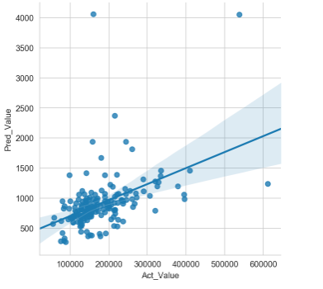
Build Model 1
Score at 85%
Featues are:
NOT Renovate-able Dataframe
Numerics columns

Slide 5
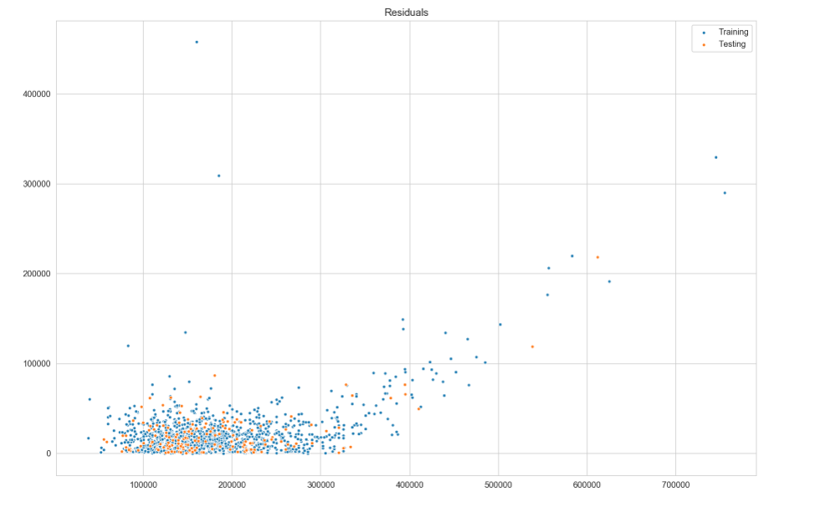
Residuals Calculation

Slide 6
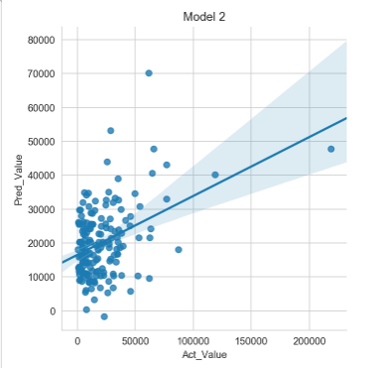
Build Model 2
Score at 16%
Featues are:
ARE renovate-able Dataframe
Dummies columns

Slide 7
THANK YOU

